Slide 1
ABSTRACTION:
The word "vote" means to choose from a list, to elect or to determine. The main goal of voting (in a scenario involving the citizens of a given country) is to come up with leaders of the people's choice
Most countries, India not an exception have problems when it comes to voting. Some of the problems involved include ridging votes during election, Insecure or inaccessible polling
stations, inadequate polling materials and also in experienced personnel. This online voting/polling system seeks to address the above issues. It should be noted that with this system in place, the users, citizens in this case shall be given ample time during the voting period. They shall also be trained on how to vote online before the election time.

Slide 2
CONTENTS:
INTRODUCTION ------------------------------------------------------------1
OBJECTIVE ---------------------------------------------------------------------2
OLD METHODS OF VOTING --------------------------------------------3
DATA FLOW DIAGRAM ---------------------------------------------------4
ER DIAGRAM ------------------------------------------------------------------5
SYSTEM REQUIREMENTS -------------------------------------------------6
HARDWARE REQUIREMENTS -------------------------------------------7
MODULES ----------------------------------------------------------------------8-9
SCREENSHOTS ---------------------------------------------------------------10-14
CODING ------------------------------------------------------------------------15-17
CONCLUSIONS --------------------------------------------------------------18
REFERENCE -------------------------------------------------------------------19

Slide 3
INTRODUCTION:
“VOTING SYSTEM” is an voting technique. In this system people who are citizens and whose age is above 18 years of age and any sex can give his\her vote online without going to any physical polling station. There is a database which is maintained in which all the names of voters with complete information is stored.
In “VOTING SYSTEM” a voter can use his\her voting right online without any difficulty. He\She has to be registered first for him/her to vote manually. Registration is mainly done by the system administrator for security reasons.
After registration, the voter is assigned a secret Voter ID with which he/she can use to log into the system and enjoy services provided by the system such as voting. If invalid/wrong details are submitted, then the citizen is not registered to vote.
BCA(CO-ED),SHARNBASVA UNIVERSITY,KALABURAGI

Slide 4
OBJECTIVES OF VOTING SYSTEM:
The specific objectives of the project include:
Reviewing the existing/current voting process or approach
Coming up with an automated voting system
Implementing a an automated/online voting system
Validating the system to ensure that only legible voters are allowed to vote.
BCA(CO-ED),SHARNBASVAUNIVERSITY,KALABURAGI

Slide 5
OLD METHODS OF VOTING:
Paper-based voting: The voter gets a blank ballot and use a pen or a marker to indicate he want to vote for which candidate. Hand-counted ballots is a time and labor consuming process, but it is easy to manufacture paper ballots and the ballots can be retained for verifying, this type is still the most common way to vote.
Lever voting machine: Lever machine is peculiar equipment, and each lever is assigned for a corresponding candidate. The voter pulls the lever to poll for his favorite candidate. This kind of voting machine can count up the ballots automatically. Because its interface is not user-friendly enough, giving some training to voters is necessary.
Direct recording electronic voting machine: This type, which is abbreviated to DRE, integrates with keyboard; touch screen, or buttons for the voter press to poll. Some of them lay in voting records and counting the votes is very quickly. But the other DRE without keep voting records are doubted about its accuracy.
Punch card: The voter uses metallic hole-punch to punch a hole on the blank ballot. It can count votes automatically, but if the voter’s perforation is incomplete, the result is probably determined wrongfully.
Optical voting machine: After each voter fills a circle correspond to their favorite candidate on the blank ballot, this machine selects the darkest mark on each ballot for the vote then computes the total result. This kind of machine counts up ballots rapidly. However, if the voter fills
BCA(CO-ED),SHARNBASVAUNIVERSITY,KALABURAGI

Slide 6
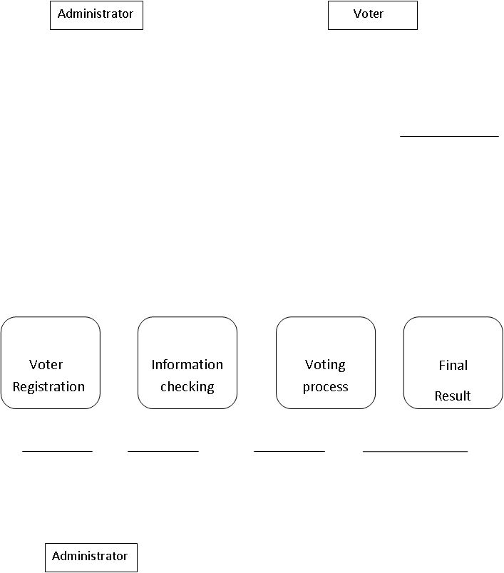
DATA FLOW DIAGRAM :
VOTING SYSTEM
Login
Login Process
voter data stored data voting data final result
Election Commissioner
BCA(CO-ED),SHARNBASVAUNIVERSITY,KALABURAGI

Slide 7
ER Diagram:
Voter
Registration
Process
Candidates
Registered Voter
Database
Registered Candidate
Add Voters
Voting
Add Candidates
Update Voter Details
Update Candidate
Details
ADMIN
Delete Candidate
Check Results
BCA(CO-ED),SHARNBASVAUNIVERSITY,KALABURAGI

Slide 8
SOFTWARE REQUIREMENTS:
MYSQL- It allows combination, extraction, manipulation and organization of data in the voters’ database. It is platform independent and therefore can be implemented and used across several such as Windows, Linux server and is compatible with various hardware mainframes. It is fast in performance, stable and provides business value at a low cost.
PHP-This is for advanced user who find PHP codes easy to work with.
HTML-CSS: HTML and CSS are scripting languages used to create a web page and web applications. HTML provides web page structure, whereas CSS is mainly used to control web page styling.
Testing- is done via XAMPP SERVER.
Web browsers: Mozilla Firefox, Google chrome, Opera and Internet Explorer
BCA(CO-ED),SHARNBASVAUNIVERSITY,KALABURAGI

Slide 9
PHP :-

Slide 10
HARDWARE REQUIREMENTS:
Microsoft Windows XP Professional SP3/Vista SP1/Windows 7 Professional:
Processor: 800MHz Intel Pentium III or equivalent
Memory: 512 MB
Disk space: 750 MB of free disk space
Ubuntu 9.10:
Processor: 800MHz Intel Pentium III or equivalent
Memory: 512 MB
Disk space: 650 MB of free disk space
BCA(CO-ED),SHARNBASVAUNIVERSITY,KALABURAGI

Slide 11
MODULES:
The System Comprises Of 5 Major Modules With Their Sub modules As Follows :
Add Organization
Add Position
Add Nominees
Add Voters
Vote Result
Adminatore Login
Student Login
BCA(CO-ED),SHARNBASVAUNIVERSITY,KALABURAGI

Slide 12
MODULES DESCRIPTION:
Admin Login page:
the page where the system admin will submit their system credential to access the system data
Home page:
the page where the system users will be redirected after login into the voting system. This page display the available modules data summary
Organization page :
The page where we can add organizations and also see the lists of organization
Add position page:
Here we to add positions for available organization and list them.
Add nominees page:
The page where we can add nominees details such as name ,position
Add voters:
The page where we can add details of voters to vote and assign ID no. to voters
Vote results:
The page where see vote results
BCA(CO-ED),SHARNBASVAUNIVERSITY,KALABURAGI

Slide 13
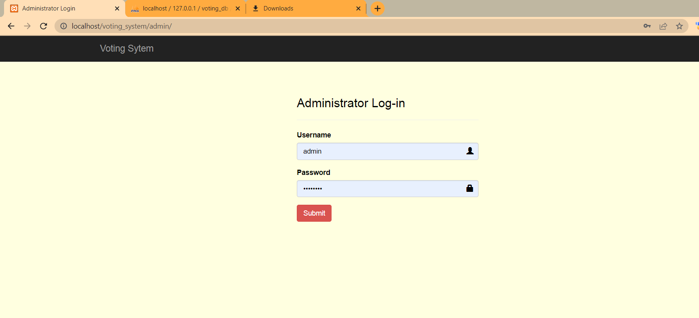
SCREENSHOTS:
ADMIN LOGIN PAGE:
BCA(CO-ED),SHARNBASVAUNIVERSITY,KALABURAGI

Slide 14
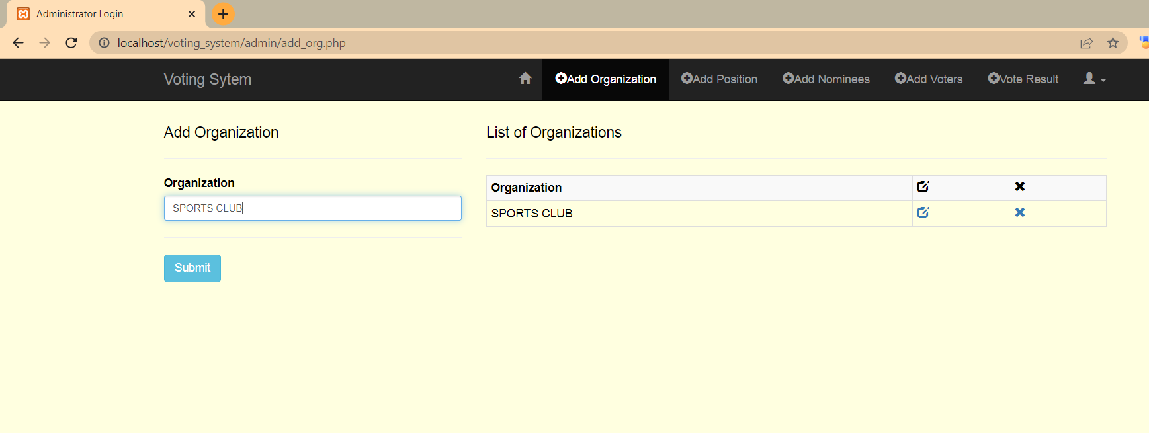
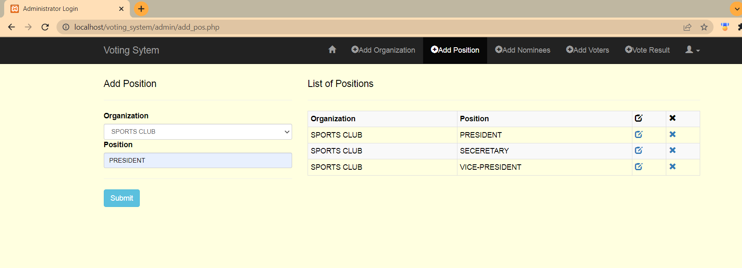
ADD ORGANIZATION PAGE:
ADD POSITION PAGE:
BCA(CO-ED),SHARNBASVAUNIVERSITY,KALABURAGI

Slide 15
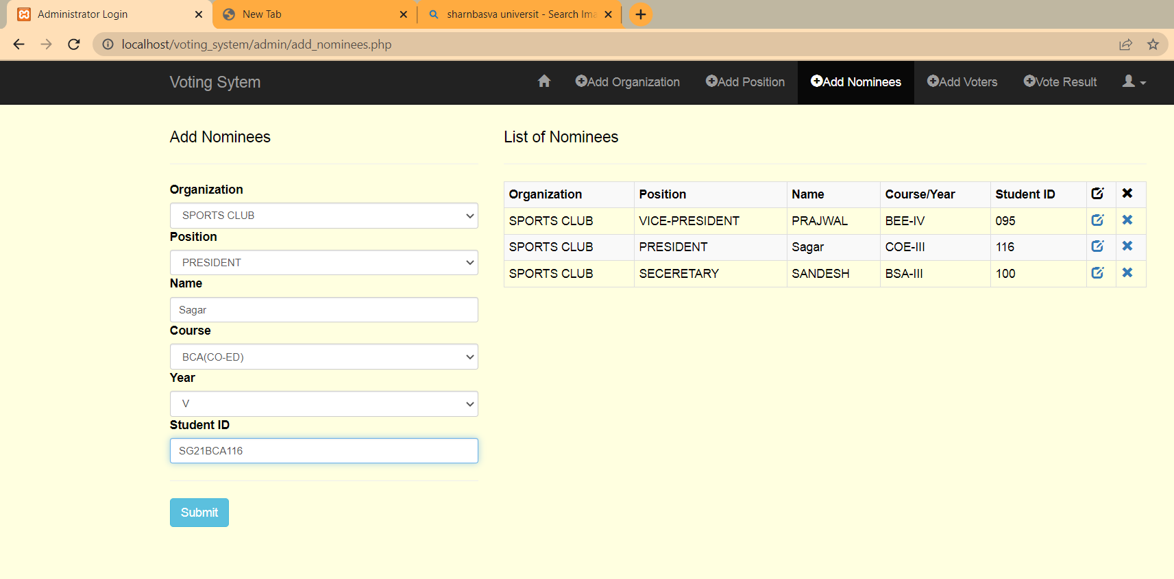
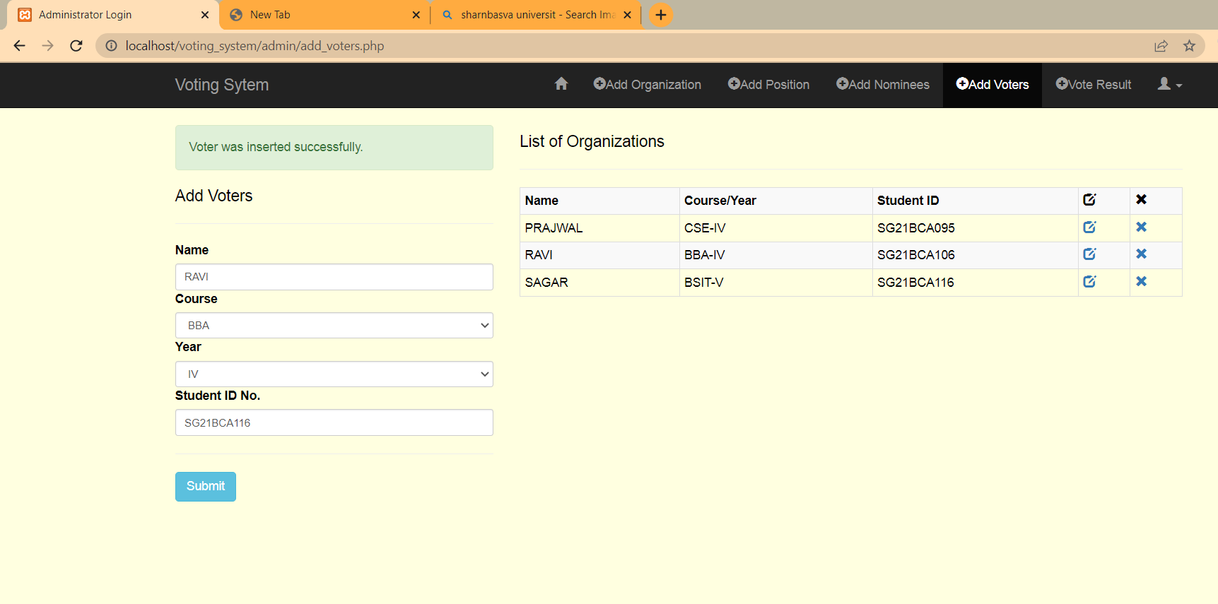
ADD NOMINEES PAGE:
ADD VOTERS PAGE:
BCA(CO-ED),SHARNBASVAUNIVERSITY,KALABURAGI

Slide 16
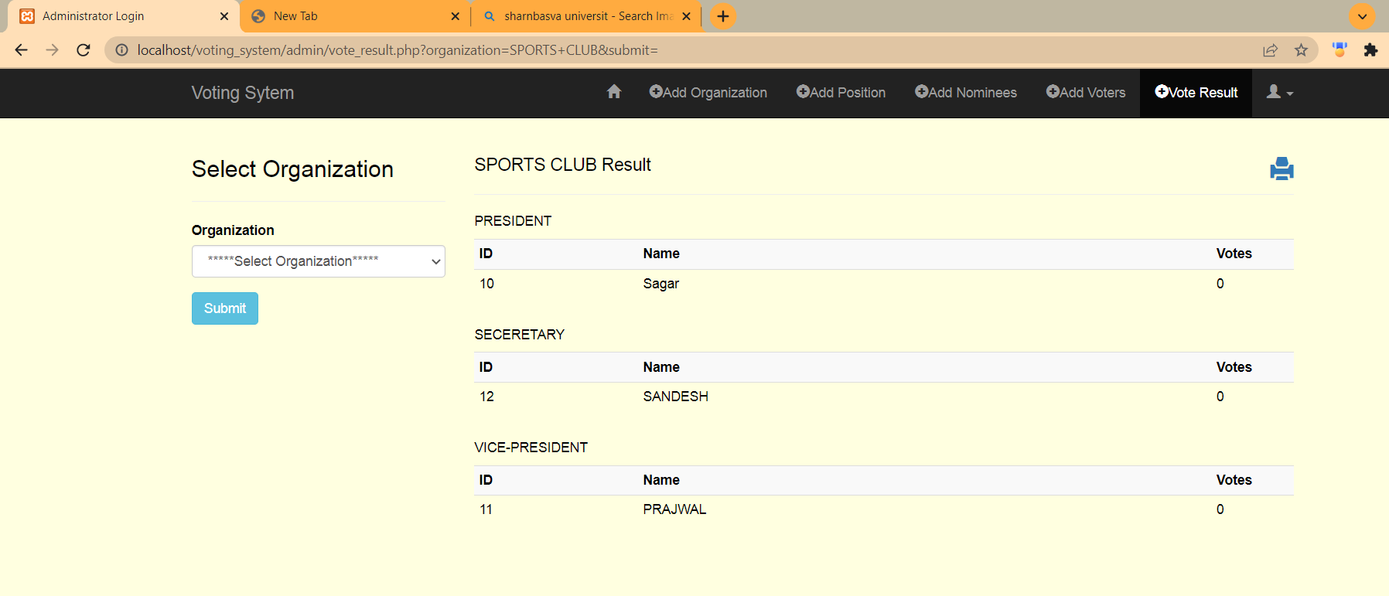
VOTE RESULT PAGE:
BCA(CO-ED),SHARNBASVAUNIVERSITY,KALABURAGI

Slide 17
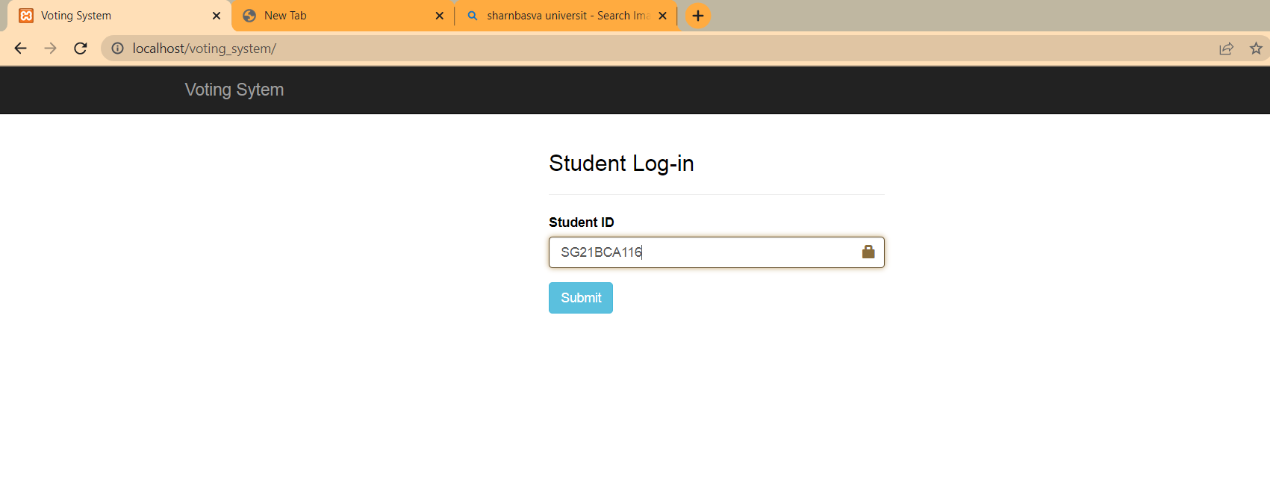
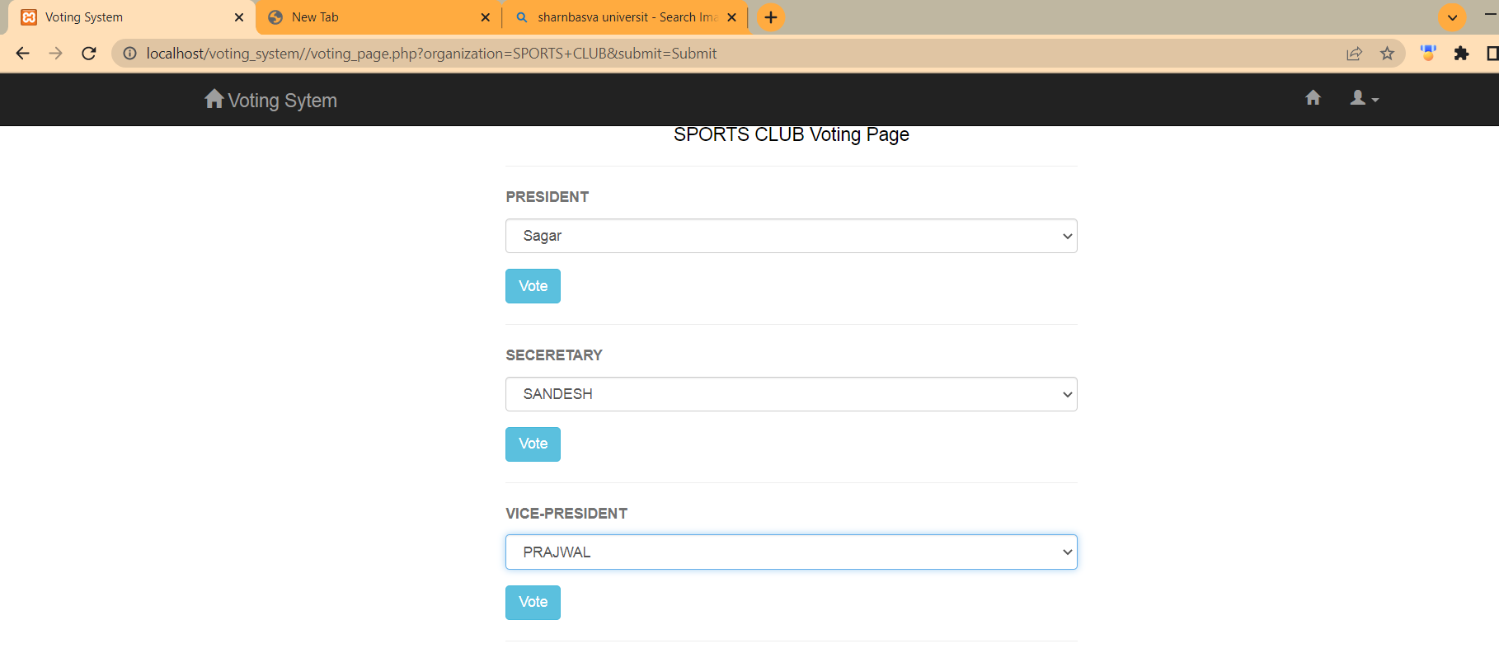
STUDENT LOGIN PAGE:
VOTING PAGE:
BCA(CO-ED),SHARNBASVAUNIVERSITY,KALABURAGI

Slide 18
CODING:
?php
//Start session
session_start();
unset($_SESSION['ID']);
unset($_SESSION['NAME']);
unset($_SESSION['COURSE']);
unset($_SESSION['YEAR']);
unset($_SESSION['STUD_ID']);
?>
<!DOCTYPE HTML>
<html lang="en-US">
<head>
<meta charset="utf-8">
<meta name="viewport" content="width=device-width, initial-scale=1.0">
<title>Voting System</title>
<link rel="stylesheet" href="assets/css/bootstrap.min.css">
<link rel="stylesheet" href="assets/css/style_voter.css">
</head>
<body>
<!-- Header -->
<nav class="navbar navbar-inverse navbar-fixed-top" role="navigation">
<div class="container">
<!-- Brand and toggle get grouped for better mobile display -->
<div class="navbar-header">
<button type="button" class="navbar-toggle collapsed" data-toggle="collapse" data-target="#bs-example-navbar-collapse-1" aria-expanded="false">
<span class="sr-only">Toggle navigation</span>
<span class="icon-bar"></span>
<span class="icon-bar"></span>
<span class="icon-bar"></span>
</button>
<a class="navbar-brand" href="index.php">Voting Sytem</a>
</div></div><!-- /.container-fluid -->
</nav>
<!-- End Header -->
<div class="container">
<div class="row">
<div class="col-md-4 col-md-offset-4">
<div class="login-con">
<h3>Student Log-in</h3><hr>
<?php
if(isset($_SESSION['ERROR_MSG_ARRAY']) && is_array($_SESSION['ERROR_MSG_ARRAY']) && COUNT($_SESSION['ERROR_MSG_ARRAY']) > 0) {
foreach($_SESSION['ERROR_MSG_ARRAY'] as $msg) {
echo "<div class='alert alert-danger'>";
echo $msg;
echo "</div>";
}
unset($_SESSION['ERROR_MSG_ARRAY']);
}
?>
BCA(CO-ED),SHARNBASVAUNIVERSITY,KALABURAGI

Slide 19
<!DOCTYPE HTML>
<html lang="en-US">
<head>
<meta charset="utf-8">
<meta name="viewport" content="width=device-width, initial-scale=1.0">
<title>Voting System</title>
<link rel="stylesheet" href="assets/css/bootstrap.min.css">
<link rel="stylesheet" href="assets/css/style_voter.css">
</head>
<body>
<!-- Header -->
<nav class="navbar navbar-inverse navbar-fixed-top" role="navigation">
<div class="container">
<!-- Brand and toggle get grouped for better mobile display -->
<div class="navbar-header">
<button type="button" class="navbar-toggle collapsed" data-toggle="collapse" data-target="#bs-example-navbar-collapse-1" aria-expanded="false">
<span class="sr-only">Toggle navigation</span>
<span class="icon-bar"></span>
<span class="icon-bar"></span>
<span class="icon-bar"></span>
</button>
<a class="navbar-brand" href="stud_page.php"><span class="glyphicon glyphicon-home"></span> Voting Sytem</a>
</div> <!-- Collect the nav links, forms, and other content for toggling -->
<div class="collapse navbar-collapse" id="bs-example-navbar-collapse-1">
<ul class="nav navbar-nav navbar-right">
<li><a href="stud_page.php"><span class="glyphicon glyphicon-home"></span></a></li>
<li class="dropdown">
<a href="#" class="dropdown-toggle" data-toggle="dropdown" role="button" aria-haspopup="true" aria-expanded="false"><span class="glyphicon glyphicon-user"></span> <span class="caret"></span></a>
<ul class="dropdown-menu">
<li><a href="process/logout.php">Logout</a></li>
</ul>
</li>
</ul>
</div><!-- /.navbar-collapse -->
</div><!-- /.container-fluid -->
</nav>
<!-- End Header -->
<?php
$readOrganization = new Voting();
$rtnReadOrg = $readOrganization->READ_ORG();
?>
<div class="container">
<div class="row">
<div class="col-md-4 col-md-offset-4">
<h3 style="text-align: center;">Select Organization</h3><hr />
<h4>Welcome <?php echo $_SESSION['NAME']; ?></h4>
<?php if($rtnReadOrg) { ?>
<form action="voting_page.php" method="GET" role="form">
<div class="form-group">
<label for="organization">Organization</label>
<select required class="form-control" name="organization">
<option value="">*****Select Organization*****</option>
<?php while($rowOrg = $rtnReadOrg->fetch_assoc()) { ?>
<option value="<?php echo $rowOrg['org']; ?>"><?php echo $rowOrg['org']; ?></option>
<?php } //End while ?>
</select>
</div>
<div class="form-group">
<input type="submit" name="submit" value="Submit" class="btn btn-info">
</div>
</form>
<?php $rtnReadOrg->free(); ?>
<?php } //End if ?>
</div>
</div>
</div>
<!-- Footer -->
<nav class="navbar navbar-inverse navbar-fixed-bottom" role="navigation">
BCA(CO-ED),SHARNBASVAUNIVERSITY,KALABURAGI

Slide 20
<?php
//Include authentication
require("process/auth.php");
//Include database connection
require("config/db.php");
//Include class Voting
require("classes/Voting.php");
?>
<!DOCTYPE HTML>
<html lang="en-US">
<head>
<meta charset="utf-8">
<meta name="viewport" content="width=device-width, initial-scale=1.0">
<title>Voting System</title>
<link rel="stylesheet" href="assets/css/bootstrap.min.css">
<link rel="stylesheet" href="assets/css/style_voter.css">
</head>
<body>
<!-- Header -->
<nav class="navbar navbar-inverse navbar-fixed-top" role="navigation">
<div class="container">
<!-- Brand and toggle get grouped for better mobile display -->
<div class="navbar-header">
<button type="button" class="navbar-toggle collapsed" data-toggle="collapse" data-target="#bs-example-navbar-collapse-1" aria-expanded="false">
<span class="sr-only">Toggle navigation</span>
<span class="icon-bar"></span>
<span class="icon-bar"></span>
<span class="icon-bar"></span>
</button>
<a class="navbar-brand" href="stud_page.php"><span class="glyphicon glyphicon-home"></span> Voting Sytem</a>
</div>
<!-- Collect the nav links, forms, and other content for toggling -->
<div class="collapse navbar-collapse" id="bs-example-navbar-collapse-1">
<ul class="nav navbar-nav navbar-right">
<li><a href="stud_page.php"><span class="glyphicon glyphicon-home"></span></a></li>
<li class="dropdown">
<a href="#" class="dropdown-toggle" data-toggle="dropdown" role="button" aria-haspopup="true" aria-expanded="false"><span class="glyphicon glyphicon-user"></span> <span class="caret"></span></a>
<ul class="dropdown-menu">
<li><a href="process/logout.php">Logout</a></li>
</ul>
</li>
</ul>
</div><!-- /.navbar-collapse -->
</div><!-- /.container-fluid -->
</nav>
<!-- End Header -->?php
if(isset($_GET['organization'])) {
$org = $_GET['organization'];
}
?>
BCA(CO-ED),SHARNBASVAUNIVERSITY,KALABURAGI

Slide 21
CONCLUSION:
This Voting system will manage the Voter’s information by which voter can login and use his voting rights. The system will incorporate all features of Voting system. It provides the tools for maintaining voter’s vote to every party and it count total no. of votes of every party. There is a DATABASE which is maintained by the ELECTION COMMISION OF INDIA in which all the names of voter with complete information is stored.
In this user who is above 18 year’s register his/her information on the database and when he/she want to vote he/she has to login by his id and password and can vote to any party only single time. Voting detail store in database and the result is displayed by calculation. By online voting system percentage of voting is increases. It decreases the cost and time of voting process. It is very easy to use and It is vary less time consuming. It is very easy to debug.
BCA(CO-ED),SHARNBASVAUNIVERSITY,KALABURAGI

Slide 22
REFERENCE :
https://itsourcecode.com/free-projects/php-project/online-voting-system-project-in-php-with-source-code/
https://www.sourcecodester.com/
https://www.w3schools.com/
https://www.google.co.in/
BCA(CO-ED),SHARNBASVAUNIVERSITY,KALABURAGI

Slide 23
THANK YOU
BCA(CO-ED),SHARNBASVAUNIVERSITY,KALABURAGI

